Slide 1
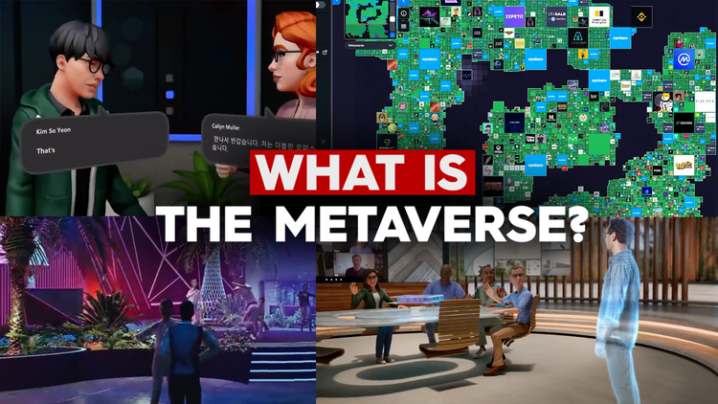
Ahmad Jajja

Slide 2
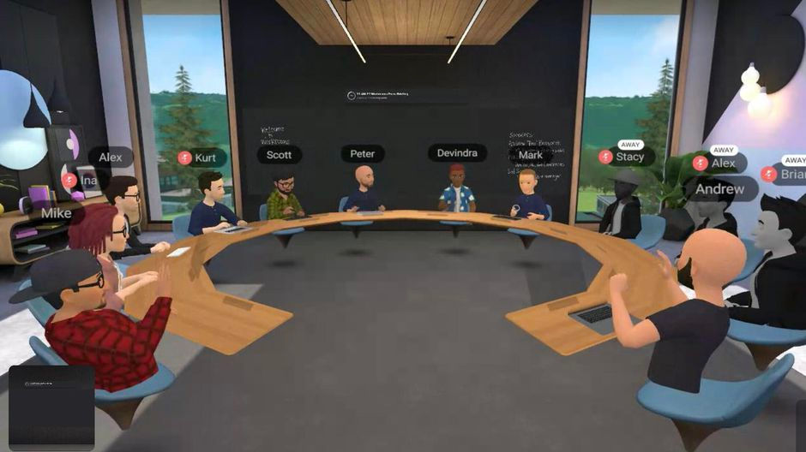
Future of the internet
Muhammad Umar Ahmad

Slide 3

Ahmad Jajja

Slide 4
Why Waiting now?
Before Knowing Metaverse.
Looking back to the history of internet
Ahmad Jajja

Slide 5
Role of vannevar Bush?
In the 1930s, Vannevar Bush, then president of the Carnegie Institution of Washington, began work on a hypothetical electromechanical device that would store all books, records,and communications, and mechanically link them together.
In 1939-41, President Roosevelt approved the atomic bomb program known as the Manhattan Project, following a meeting with Bush
Ahmad Jajja

Slide 6
Bush’s famous essays
After world war 2nd, Bush wrote two essays in 1945
that are
Science the Endless Frontier
As we may think
Ahmad Jajja

Slide 7
HTML Creation(WEB 1.0)
Starting in the 1960s, the US government funded a variety of projects within the Department of Defense, in partnership with a network of external researchers, universities, and other non government institutions that together developed the foundation of the internet.
The creation and evolution of “hypertext,” one of the underlying concepts of the World Wide Web, which is typically written in the HyperText Markup Language (HTML)
Ahmad Jajja

Slide 8
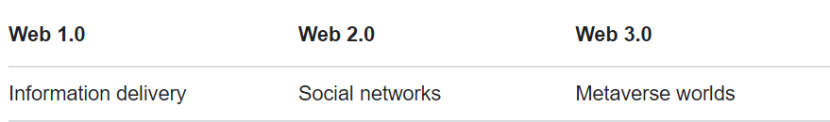
Today’s Internet(WEB 2.0)
Web 2.0 is the current version of the web with which we are all familiar.
Web 2.0 is used in many websites today.
Ahmad Jajja

Slide 9
Now Let’s Dive Into Metaverse
Ahmad Jajja

Slide 10
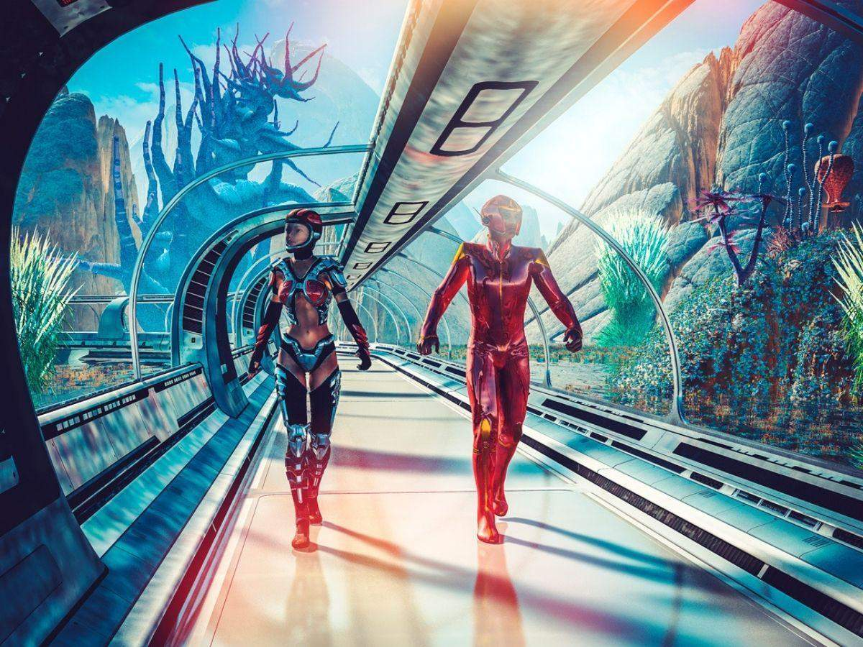

Slide 11
Metaverse’s Imagination
‘Snow Crash’ is a science-fiction novel written by Neal Stephenson and published in 1992. The term ‘metaverse’, which has been coined by the author, is a virtual reality space which uses internet and augmented reality. In the novel, users are represented by avatars and can interact with other human beings and software agents.
Ahmad Jajja

Slide 12
What is Metaverse?
A massively scaled and interoperable network of real-time rendered 3D virtual worlds that can be experienced synchronously and persistently by an effectively unlimited number of users with an individual sense of presence,
and with continuity of data, such as identity, history, entitlements, objects,communications, and payments.
Ahmad Jajja

Slide 13
Massively Scaled
Global scale (everyone everywhere just like the Internet is now).
It must have a massively scaled number of virtual
worlds if it is to be “the Metaverse.”
Ahmad Jajja

Slide 14
Massively Scaled( Metagalaxies )
Within the Metaverse, there might be “metagalaxies,” a collection of virtual worlds that all operate under a single authority and that are clearly connected by a visual layer.
One way to think about a Metagalaxy is to think of Facebook’s role in the internet.
In a simplified sense, it’s today’s version of a 2D Metagalaxy
Ahmad Jajja

Slide 15
Virtual world
For decades, the primary reason to build a virtual world was for a video game, such as The Legend of Zelda or Call of Duty, or as part of a feature film, such as those of Disney’s Pixar or for Warner Bros.’ The Matrix.
This is why the Metaverse is often misdescribed as a game or entertainment experience.
Ahmad Jajja

Slide 16
Virtual world
virtual worlds can reproduce the “real world” exactly.
The purpose of a virtual world can be “game-like,” which is to say there is an objective such as winning, killing, scoring, defeating, or solving, or the purpose can be “non-game-like” with objectives such as educational or vocational training, commerce, socializing, meditation, fitness, and more.
Ahmad Jajja

Slide 17
Interoperability
User’s ability to take her virtual “content,” such as an avatar or a backpack, from one virtual world to another, where it might also be changed, sold, or remixed with other goods.
Ahmad Jajja

Slide 18
Interoperability
This isolation and fragmentation stems from the fact that today’s virtual worlds, and their builders, never designed their systems or experiences to be interoperable.
If Call of Duty wants to import an avatar from Fortnite, it
will likely want to restyle the avatar to fit Call of Duty’s gritty realism.
Ahmad Jajja

Slide 19
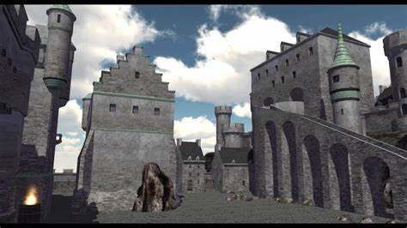
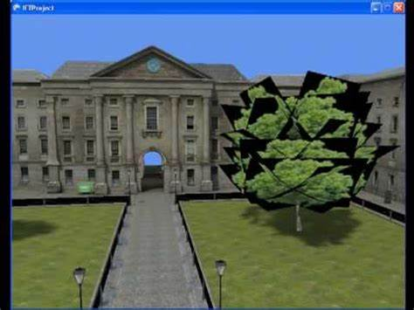
Interoperability
Real-Time Rendering
This isolation and fragmentation stems from the fact that today’s virtual worlds, and their builders, never designed their systems or experiences to be interoperable.
If Call of Duty wants to import an avatar from Fortnite, it
will likely want to restyle the avatar to fit Call of Duty’s gritty realism.
Ahmad Jajja

Slide 20
Real-Time Rendering
Rendering is the process of generating a 2D or 3D object or environment using a computer program.
Real-time rendering refers to the process of generating a computer image as we experience it in near real-time
Ahmad Jajja

Slide 21
Synchronous
Synchronous means that we’re in a shared experience.
In the preschool classroom, we observe the value of shared physical experience. From playdough to the playground, shared experiences connect kids. They built strong friendships that could last decades and spread across time zones.
Ahmad Jajja

Slide 22
Persistence
Persistence is philosophical, what endures, what continues. Almost nothing in the virtual world today is persistent.
According to Stephenson’s Snow Crash,. Nearly everything and anything done by any user, at any time, can persist forever. This applies not just to the virtual world, but to the
individual items in it.
And per the principles of interoperability,these modifications would persist wherever we go.
Ahmad Jajja

Slide 23
Persistence
The literal version of Stephenson’s Metaverse may not even be desirable. He imagined individuals waking up in the Metaverse inside their virtual homes, then walking or taking a train to a virtual bar. While skeuomorphism† often
has utility, “The Street” as a single unifying layer for everything in the virtual world likely does not. Most participants in the Metaverse would rather teleport from destination to destination..
Ahmad Jajja

Slide 24
Next Internet!
Understanding the Metaverse as the “next-generation internet” helps explain much more than its potential for disruption. Consider, once again, that there is no plural form of the term “internet.” There is no “Facebook internet” or “Google internet.” Instead, Facebook and Google operate platforms, services, and hardware that in turn operate on the internet
Ahmad Jajja

Slide 25
Video games are deriving the next internet
If the Metaverse is indeed a successor to the internet, it might seem odd that its pioneers come from the video gaming industry. Because all virtual world and 3D concepts are already using in gaming.
If we look more closely at this history, we can see why gaming, a $180- billion leisure industry, seems poised to alter the $95-trillion world economy.
Ahmad Jajja

Slide 26
Video games are deriving the next internet
The software solutions that are best at real-time 3D
rendering come from gaming, too. The most notable examples are Epic Games’ Unreal Engine, as well as Unity Technologies’ eponymous engine,but there are dozens of video game developers and publishers with highly capable proprietary real-time rendering solutions.
Ahmad Jajja

Slide 27
Games w.r.t metaverse(Virtual Reality/3D)
Second Life
Mine Craft
Roblox
PubG
FreeFire.
GTA 5
Call of Duty
Legend of zelda
Adopt me!
Super Mario Bros
New Horrizon
Ahmad Jajja

Slide 28
Thanks!
Muhammad Umar Ahmad
Any questions?

